Slide 1
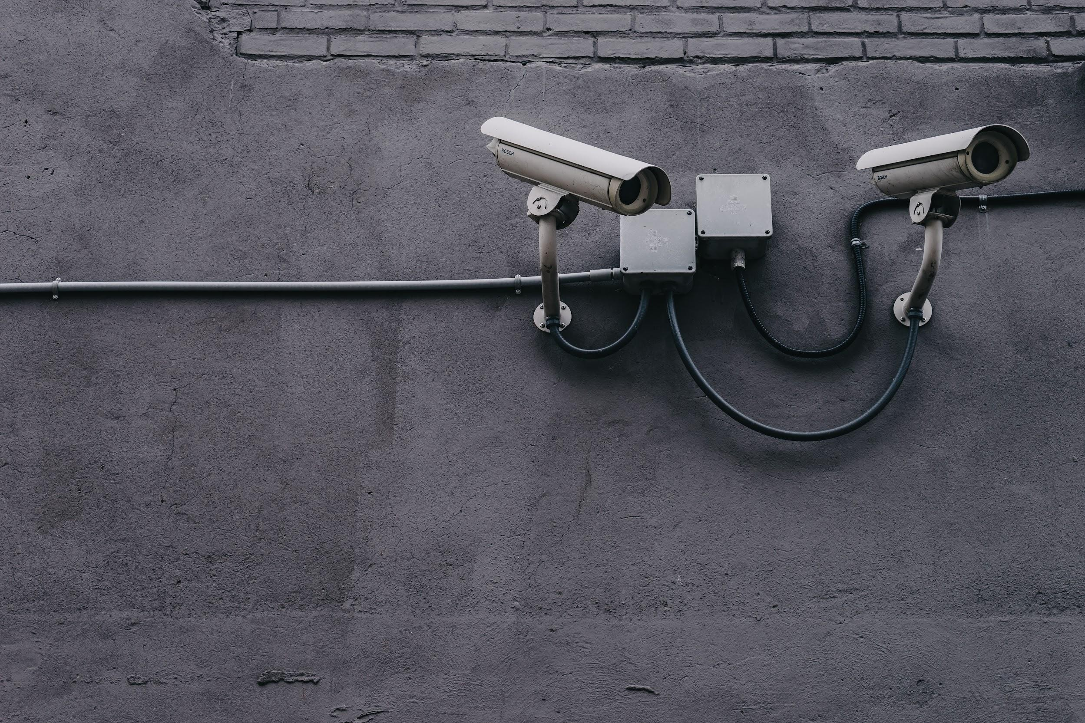
Smart Surveillance
Project Report by
Tanmay Prakash, 10800218007
Manisha Kumari, 10800218055
Kumari Simran, 10800218057 Hardik Khanuja , 10800218065
Guided by
Dr. Anup Kr Mukhopadhyay

Slide 2
Definition of Surveillance System
A surveillance system / CCTV is the one that uses a combination of cameras and computer sensors to closely monitor specific locations.
The cameras may be conspicuous and out in the open to detect crime,
or they can be more hidden and discreet to record evidence with fewer chances of being tampered with.
Footage can be monitored live by a security guard, monitored
remotely if using an IP camera and system (more on that in a moment) by a monitoring company, or can simply be recorded and stored by a DVR (digital video recorder) or NVR (network video recorder) for review later should the need arise.

Slide 3
Surveillance
Information for Action
Surveillance is the bridge between what we think is happening and what actually is happening

Slide 4


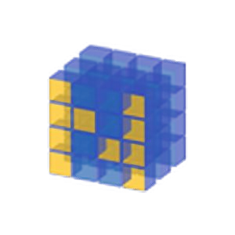

Installations and Technology
Opencv-python
Tkinter
Numpy
Pickle
Cvzone
Scikit-image
Face_recognition

Slide 5
Advantages of our Surveillance System
We all know that the job of security guard sitting in front of computer continuously monitoring via CCTV is quite tiring. But using this smart surveillance system we can tackle that problem with ease.
This Surveillance system has some features through which monitoring the area via CCTV become less complicated and the person don’t have to sit and monitor the camera 24/7.
It automatically detects any unwanted activity and alerts the system like detecting monitoring and identify the individuals, etc.
It also solves the problem of parking vehicles in the area by detecting whether that area has empty space for parking or not.

Slide 6
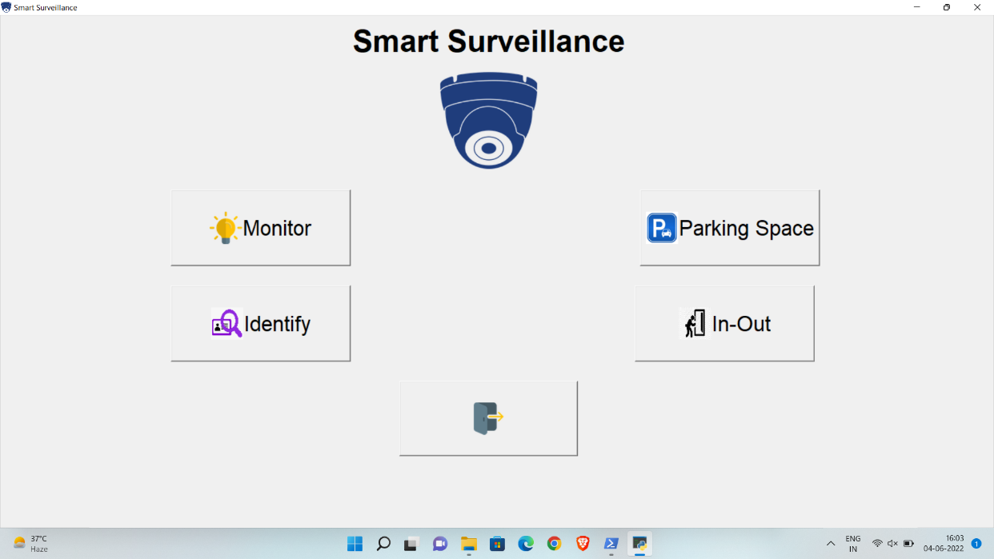
What can our Surveillance System can do ?
Motion Detection
Identification
Parking Space Detection
In/Out (Entry/exit detection)
Figure. Main GUI Screen

Slide 7
Features of our Surveillance System - Quick glance

Slide 8
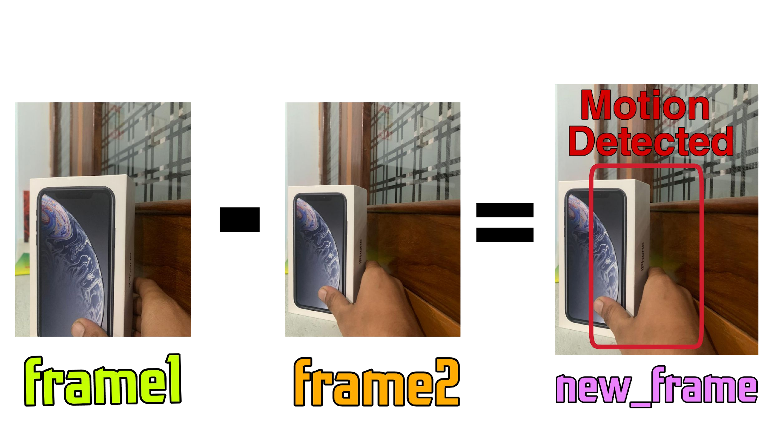

Monitor
It smartly analyzes frames and find the stolen objects.
Uses Structural Similarity to find differences in frames.
SSIM is used to measure similarity between the two frames.

Slide 9
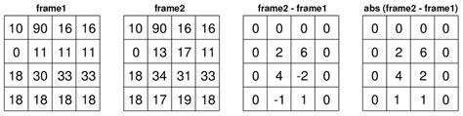
Working
Initially the frame is taken when nothing is stolen
Continuously checks for any motion
If motion happens, wait until motion ends
When motion ends then capture another image
It basically does absolute difference between two consecutive frames.
From that difference, we detect contours/boundaries.
If boundaries are 0 then no motion, and vice-versa.

Slide 10
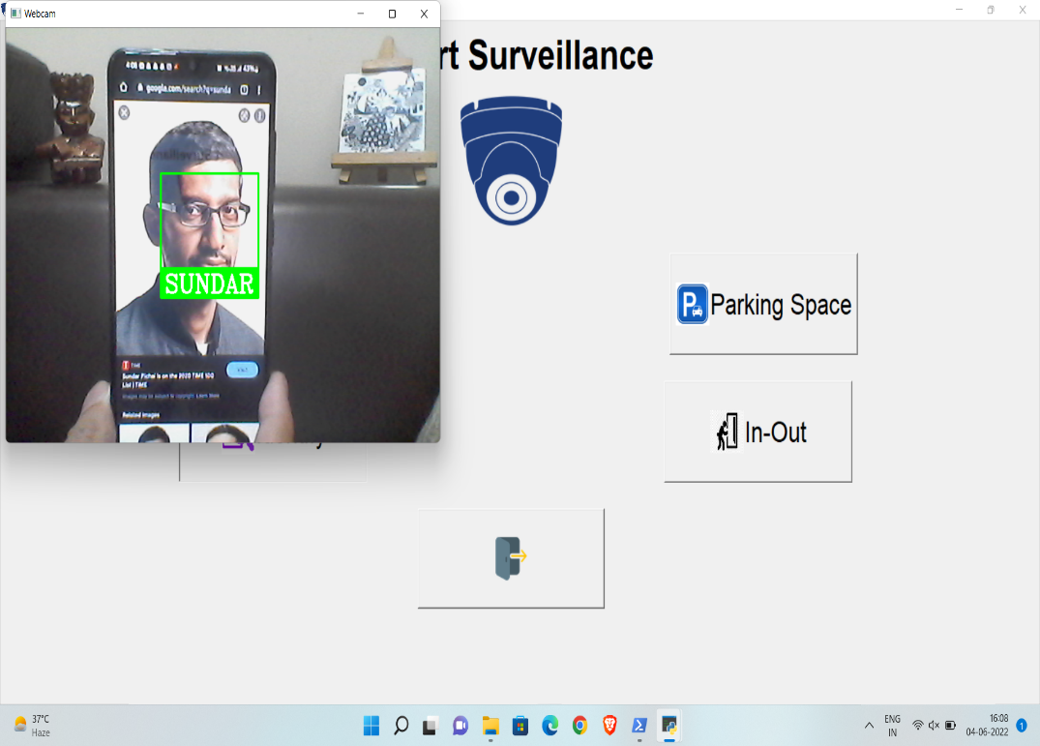
Identification
SIMRAN
This feature allows to train the model on known circle of us (images to be fed by us).
Next time just predict if the person entered is known or not.
Uses LBPH Face Recogniser Algorithm.

Slide 11
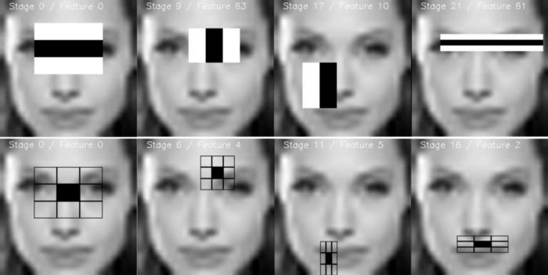
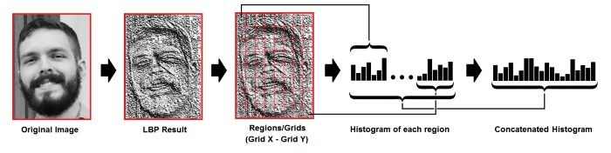
Working
First we train the model with dataset.
Now use Haar Cascade classifier to detect the face in the frame
Then we use LBPH to identify if the face in the frame is know or not.
Face detection
training

Slide 12
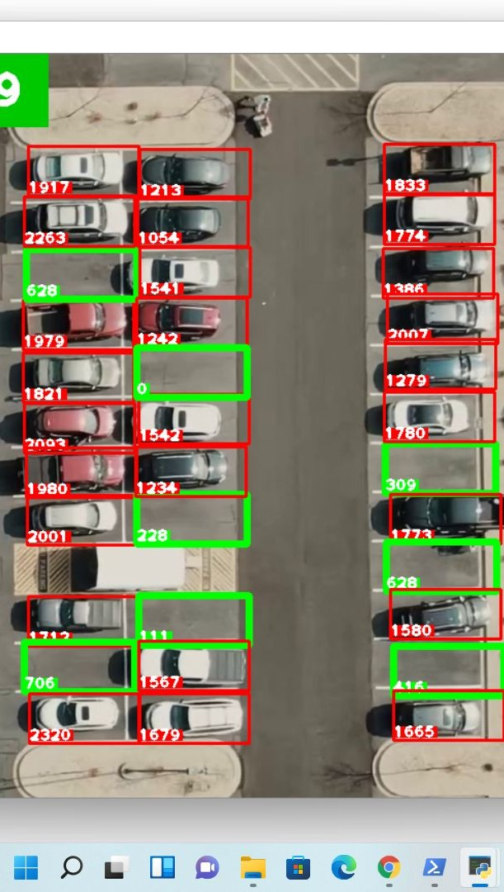
Parking Space
This feature is efficient for finding
vacant spaces for parking a car.
It uses Gaussian and median blur to calculate pixels in a parking spot.
If the number of pixels is high, it means that the spot is occupied; and if it’s low, it means it is available for parking.

Slide 13
Working
It uses basic image processing techniques to find a free space designated for parking
Since the frame doesn’t change (because of the CCTV being fixed), we can pre-determine the position of the frame in which the car can be parked.
After the positions are determined, we store them in a file, which later can be used to determine the free positions.
With the help of Gaussian and Median blur (which check for any vehicle-like pixel), we determine if the parking space is empty or not.

Slide 14
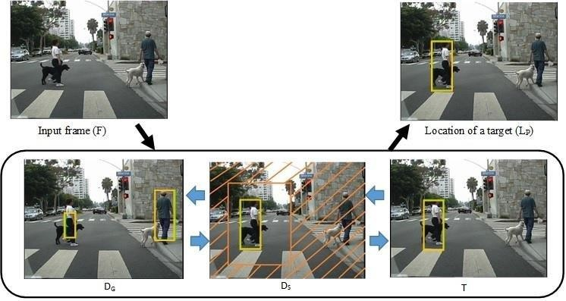
In & Out Detection
It first detects any motion in two ends (either left, or right)
It then follows the motion in that direction, and marks it in rectangles.

Slide 15
Working
It first checks for motion.
If there is motion, then it checks the side of motion- either left or right.
If motion from left then it will check if motion ends towards the right side and captures the image; and vice versa.

Slide 16
Need for Surveillance System
Installation of CCTV cameras helps not only to prevent crimes due to visual control but also to charge criminals using the information recorded by video cameras. If we install a video surveillance system, we will be able to:
monitor every stage of the manufacturing process;
prevent quality failure, violation of working conditions, safety rules;
have full and recorded data about production accidents;
prevent thefts and damage of manufactured goods and products as well as manufacturing equipment.

Slide 17
Future Scope
Integration of Video Surveillance with Other Security Systems:
Video surveillance system.
Access control system, which enables to keep a record of staff working hours, receive information about the zonal location of employees.
System of automatic recognition of car license plates at the entrance or on parking lots, which gives visitors statistics, grants access to parking lots by permits.
Security alarm system, fire alarm system, fire fighting system. Security functions are performed in the most efficient way with the help of motion detectors on video cameras and intrusion detection sensors. When an undesirable event happens in a certain area, the operator is immediately informed by the system.

Slide 18

A good Surveillance System does not necessarily ensure making of right decisions;
but it reduces the chances of wrong ones

Slide 19
Learning guide and planning.https://www.computervision.zone/
Guide to OpenCV.https://opencv.org/
Guide to
Tkinter.https://docs.python.org/3/library/tkinter.html
4. Working process for face_recognition System.https://face-recognition.readthedocs.io/en/late st/readme.html
References

Slide 20
Thank You.

